Slide 1
Chapter 9
Behavioral Design Patterns
Interpreter
Iterator
Mediator
Observer
State
Chain of Responsibility
Command
Template

Slide 2
Interpreter Design Pattern
1 of 8

Slide 3
Interpreter
Design Purpose
Interpret expressions written in a formal grammar.
Design Pattern Summary
Represent the grammar using a recursive design pattern form: Pass interpretation to aggregated objects.
Adapted from Software Design: From Programming to Architecture by Eric J. Braude (Wiley 2003), with permission.

Slide 4
Interpreter Design Pattern
AbstractExpression
interpret()
1..n
Client
TerminalExpression
interpret()
NonTerminalExpression
interpret()
Adapted from Software Design: From Programming to Architecture by Eric J. Braude (Wiley 2003), with permission.

Slide 5
Interpreter Sequence Diagram
:Client
AbstractExpression
:NonterminalExpression
NonterminalExpression
interpret()
...
...
create &
interpret()
TerminalExpression
...
create &
interpret()
Adapted from Software Design: From Programming to Architecture by Eric J. Braude (Wiley 2003), with permission.

Slide 6
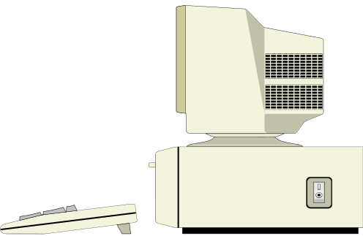
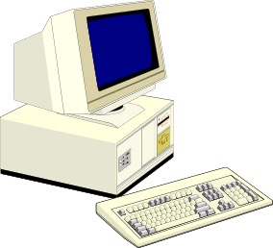
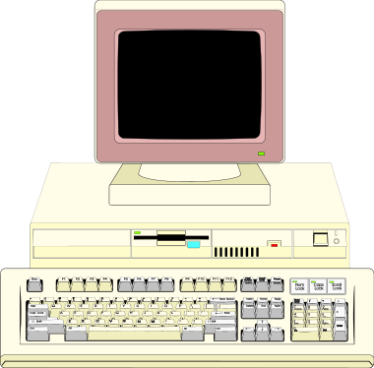
Example Interpreter Application: Network Assembly
400Mhz & 128MB
assemble ….
260Mhz & 64MB
260Mhz & 32MB
Graphics reproduced with permission from Corel.
Adapted from Software Design: From Programming to Architecture by Eric J. Braude (Wiley 2003), with permission.

Slide 7
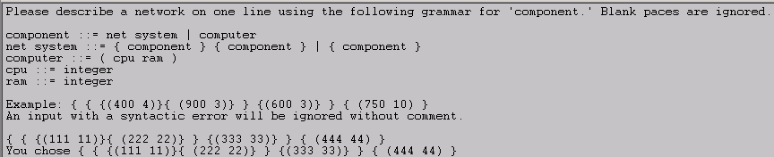
Input For Network Assembly Example
Adapted from Software Design: From Programming to Architecture by Eric J. Braude (Wiley 2003), with permission.

Slide 8
Interpreter Design Pattern
Client
Component
assemble()
NetSystem
assemble()
component1
Adapted from Software Design: From Programming to Architecture by Eric J. Braude (Wiley 2003), with permission.

Slide 9
Application of Interpreter Design Pattern
<<interface>>
Component
assemble()
0..1
Client
1
component1
NetSystem
assemble()
component2
cpu
CPU
describe()
Setup
getInputFromUser()
parse()
Computer
assemble()
RAM
describe()
ram
component ::= net_system | computer
net_system ::= { component } { component } | { component }
computer ::= {cpu ram }
cpu ::= integer
ram ::= integer
Adapted from Software Design: From Programming to Architecture by Eric J. Braude (Wiley 2003), with permission.

Slide 10
Source code example
interface Component
{
}
class Computer implements Component
{
}
class NetSystem implements Component
{
}
class CPU
{
}
class RAM
{
}
class Setup
{
main()
}
class Client
{
. . .
Component networkOrder;
. . .
networkOrder.assemble();
. . .
}

Slide 11
Key Concept: → Interpreter Design Pattern ←
-- a form for parsing and a means of processing expressions.
Adapted from Software Design: From Programming to Architecture by Eric J. Braude (Wiley 2003), with permission.

Slide 12
Iterator Design Pattern
2 of 8

Slide 13
Iterator
Design Purpose (Gamma et al)
Provide a way to access the elements of an aggregate object sequentially without exposing its underlying representation.
Design Pattern Summary
Encapsulate the iteration in a class pointing (in effect) to an element of the aggregate.
Adapted from Software Design: From Programming to Architecture by Eric J. Braude (Wiley 2003), with permission.

Slide 14
Purpose of Iterator
- given a collection of objects e.g.,
  the videos in a video store
  a directory
- having specified ways to progress through them e.g.,
  “list in alphabetical order”
  “list all videos currently on loan”
... encapsulate each of these ways
Aggregate
object
iterator2
iterator7
Adapted from Software Design: From Programming to Architecture by Eric J. Braude (Wiley 2003), with permission.

Slide 15
Iterator Class Model
Client
Iterator
setToFirst()
increment()
isDone()
getCurrentItem()
Aggregate
ConcreteIterator
AggregatedElement
1…n
ConcreteAggregate
1
Adapted from Software Design: From Programming to Architecture by Eric J. Braude (Wiley 2003), with permission.

Slide 16
Using Iterator Functions
/*
To perform desiredOperation() on elements of the aggregate according to the iteration (order) i:
*/
for( i.setToFirst(); !i.isDone(); i.increment() )
  desiredOperation( i.getCurrentElement() );
Adapted from Software Design: From Programming to Architecture by Eric J. Braude (Wiley 2003), with permission.

Slide 17
Functions for Iterator
// Iterator "points" to first element:
void setToFirst();
// true if iterator "points" past the last element:
boolean isDone();
// Causes the iterator to point to its next element:
void increment();
// Return the element pointed to by the iterator:
C getCurrentElement();
Adapted from Software Design: From Programming to Architecture by Eric J. Braude (Wiley 2003), with permission.

Slide 18

Iterator in Arrays, Vector, and in General
 |  | Iterator Operations
 |  | Set to beginning | Increment | Get current element | Check not done yet
The Iterator | Index (integer) i on array myArray | i = 0 | ++i | myArray[ i ] | i < myArray .length
 | Index (integer) j on Vector myVector | j = 0 | ++j | myVector .get( j ) | j < myVector .size()
 | Iterator (object) myIterator | myIterator .setToFirst() | myIterator .increment() | myIterator .getCurrent Element() | ! myIterator .isDone()
Adapted from Software Design: From Programming to Architecture by Eric J. Braude (Wiley 2003), with permission.

Slide 19
Imagining Iterator
Key: Intended sequence of Element objects
element:
Element
Aggregate of Element
objects
After first() executes, iterator references this object.
iterator:
Iterator
Before increment() executes, iterator references this object.
After increment() executes, iterator references this object.
Adapted from Software Design: From Programming to Architecture by Eric J. Braude (Wiley 2003), with permission.

Slide 20
Iterator Example Setup Code
// Suppose that we have iterators for forward and
// backward order: we can re-use print_employees()
List employees = new List();
ForwardListIterator forward // to go from front to back
= new ForwardListIterator ( employees );
ReverseListIterator backward // to go from back to front
= new ReverseListIterator ( employees );
client.print_employees( forward ); // print from front to back
client.print_employees( backward ); // print from back to front
Adapted from Software Design: From Programming to Architecture by Eric J. Braude (Wiley 2003), with permission.

Slide 21
An Organizational Chart Example
Vanna Presley
vice president, 4 years
Sue Miller
svce. mgr., 7 years
Sam Markham
svce. mgr., 5 years
Sal Monahan
svce. mgr., 1 year
Inez Clapp
ind. contrib., 11
Inky Conway
ind. contrib., 6
Iolanthe Carp
ind. contrib., 8
Inge Carlson
ind. contrib., 12
Adapted from Software Design: From Programming to Architecture by Eric J. Braude (Wiley 2003), with permission.

Slide 22
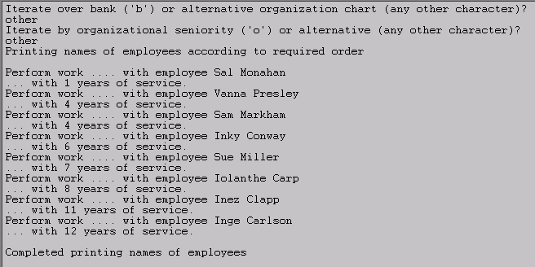
Iterating by Years of Service Over an Organization Chart
Adapted from Software Design: From Programming to Architecture by Eric J. Braude (Wiley 2003), with permission.

Slide 23
Design Goal At Work: → Flexibility , Correctness ←
Separate the “visiting” procedure from the processing of individual employees.
Adapted from Software Design: From Programming to Architecture by Eric J. Braude (Wiley 2003), with permission.

Slide 24
Class Structure for Iterator Example
Client
Setup
OrgChartDP
OrgChartIteratorDP
OrgChartIterator
first()
next()
isDone()
currentItem()
Employee
display()
Teller
ServiceIterator
Supervisor
OrgSeniorityIterator
Adapted from Software Design: From Programming to Architecture by Eric J. Braude (Wiley 2003), with permission.

Slide 25
Iterator in the Java API
<<interface>>
Iterator
next()
hasNext()
remove()
Collection
Iterator iterator()
ListIterator
List
AbstractCollection
Iter *
AbstractList
ListIterator listIterator()
ListItr *
ArrayList
Vector
* IBM implementation
Adapted from Software Design: From Programming to Architecture by Eric J. Braude (Wiley 2003), with permission.

Slide 26
Address Book Application using Java Iterator
<<interface>>
Iterator
next()
hasNext()
remove()
Collection
Iterator iterator()
ListIterator
List
AbstractList
ListIterator listIterator()
ListItr *
ArrayList
0..n
NameAddressEntry
AddressBook
* IBM implementation
Adapted from Software Design: From Programming to Architecture by Eric J. Braude (Wiley 2003), with permission.

Slide 27
Key Concept: → Iterator Design Pattern ←
-- to access the elements of a collection.
Adapted from Software Design: From Programming to Architecture by Eric J. Braude (Wiley 2003), with permission.

Slide 28
Mediator Design Pattern
3 of 8

Slide 29
Mediator
Design Purpose
Avoid references between dependent objects
Design Pattern Summary
Capture mutual behavior in a separate class
Adapted from Software Design: From Programming to Architecture by Eric J. Braude (Wiley 2003), with permission.

Slide 30
The Mediator Class Model
<<abstract>>
<<abstract>>
Mediator
Colleague
ConcreteColleague1
ConcreteColleague2
ConcreteMediator
Adapted from Software Design: From Programming to Architecture by Eric J. Braude (Wiley 2003), with permission.

Slide 31
Design Goal At Work: → Reusability and Robustness ←
Avoid hard-coded dependencies among the game’s GUI classes, enabling their use in other contexts.
Adapted from Software Design: From Programming to Architecture by Eric J. Braude (Wiley 2003), with permission.

Slide 32
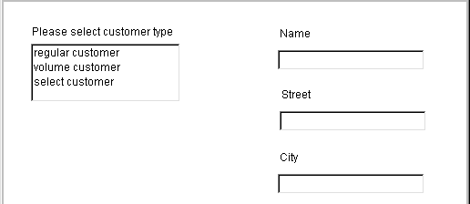
Solicitation of Customer Information (1 of 2)
Name and Location
Basic information
Adapted from Software Design: From Programming to Architecture by Eric J. Braude (Wiley 2003), with permission.

Slide 33
Solicitation of Customer Information (2 of 2)
Account Information
Customer ID
Total business
Amount due
Additional information
Adapted from Software Design: From Programming to Architecture by Eric J. Braude (Wiley 2003), with permission.

Slide 34
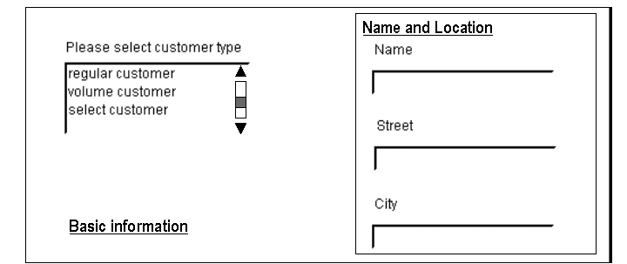
Application of Mediator To Customer Information Application
CustomerGUI
CustomerDisplay
BasicInfoGUI
CustTypeDisplay
CustInfoDisplay
Concrete
mediator
Adapted from Software Design: From Programming to Architecture by Eric J. Braude (Wiley 2003), with permission.

Slide 35
The Mediator Class Model in the Java API
ComponentListener
actionPerformed()
Component
addComponentListener()
MyComponent1
MyComponent2
MyEventListener
Adapted from Software Design: From Programming to Architecture by Eric J. Braude (Wiley 2003), with permission.

Slide 36
Key Concept: → Mediator Design Pattern ←
-- to capture mutual behavior without direct dependency.
Adapted from Software Design: From Programming to Architecture by Eric J. Braude (Wiley 2003), with permission.

Slide 37
Observer Design Pattern
4 of 8

Slide 38
Observer
Design Purpose
Arrange for a set of objects to be affected by a single object
Design Pattern Summary
The single object aggregates the set, calling a method with a fixed name on each member
Adapted from Software Design: From Programming to Architecture by Eric J. Braude (Wiley 2003), with permission.

Slide 39
Observer Design Pattern
Server part
Client part
Client
1
Source
notify()
1..n
Observer
update()
2
Observable
for all Observer’s o:
o.update();
Adapted from Software Design: From Programming to Architecture by Eric J. Braude (Wiley 2003), with permission.

Slide 40
Observer Design Pattern
Server part
Client part
Source
notify()
Observer
update()
Client
1
1..n
2
for all Observer’s o:
o.update();
ConcreteObserver
observerState
update()
ConcreteSource
state
3
Adapted from Software Design: From Programming to Architecture by Eric J. Braude (Wiley 2003), with permission.

Slide 41
Observer Applied to International
Hamburger Co.
Server part
Client part
Client
Source
notify()
1..n
Observer
update()
SeniorManagement
forecast
update()
Headquarters
demand
Marketing
marketingDemand
update()
doDisplay()
if( abs( hq.demand - marketingDemand ) > 0.01 )
{ marketingDemand = hq.getDemand();
doDisplay();
}
Adapted from Software Design: From Programming to Architecture by Eric J. Braude (Wiley 2003), with permission.

Slide 42
Design Goal At Work: → Flexibility ←
Allow mutual funds objects to easily acquire or divest of stocks.
Adapted from Software Design: From Programming to Architecture by Eric J. Braude (Wiley 2003), with permission.

Slide 43
Observer Example: Mutual Funds
Source
Observable
notifyObservers()
Observer
update( Observable, Object )
MutualFund
value
numAwesomeShares
Setup
LongTermMutualFund
….
update(…)
AwesomeInc
price
Client
MediumTermMutualFund
….
update(…)
HiGrowthMutualFund
….
update(…)
Java API Class
Key:
Developer Class
Adapted from Software Design: From Programming to Architecture by Eric J. Braude (Wiley 2003), with permission.

Slide 44
Observer in the Java API
Observable
notifyObservers()
Observer
update( Observable, Object )
MyConcreteObserver
observerState
update(…)
MyObservable
Key:
Java API Class
Developer Class
Model-View-Controller pattern : (Observable, Observer, (Client & Setup) )
data GUIs
Adapted from Software Design: From Programming to Architecture by Eric J. Braude (Wiley 2003), with permission.

Slide 45
Key Concept: → Observer Design Pattern ←
-- to keep a set of objects up to date with the state of a designated object.
Adapted from Software Design: From Programming to Architecture by Eric J. Braude (Wiley 2003), with permission.

Slide 46
State Design Pattern
5 of 8

Slide 47
State
Design Purpose
Cause an object to behave in a manner determined by its state
Design Pattern Summary
Aggregate a state object and delegate behavior to it
Adapted from Software Design: From Programming to Architecture by Eric J. Braude (Wiley 2003), with permission.

Slide 48
State Design Pattern Structure:
doRequest() behaves according to state of Target
{ targetState.handleRequest(); }
Client
Target
doRequest()
targetState
TargetState
handleRequest()
1
TargetStateA
handleRequest()
TargetStateB
handleRequest()
. . . . . .
Adapted from Software Design: From Programming to Architecture by Eric J. Braude (Wiley 2003), with permission.

Slide 49
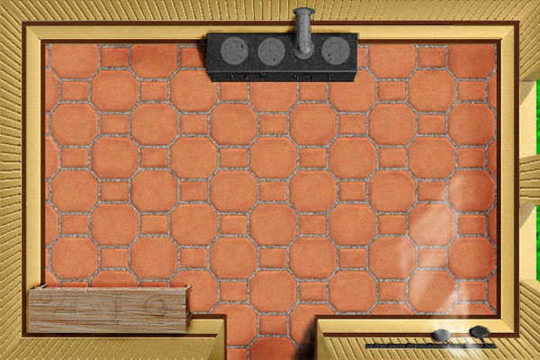


GUI For a Role-Playing Video Game
Set Characteristics
Courtesy Tom VanCourt and Corel
Adapted from Software Design: From Programming to Architecture by Eric J. Braude (Wiley 2003), with permission.

Slide 50
Design Goal At Work: → Correctness and Reusability ←
Separate the generic code for handling button clicks from the actions which depend on the game’s status at the time.
Adapted from Software Design: From Programming to Architecture by Eric J. Braude (Wiley 2003), with permission.

Slide 51
State Design Pattern Applied to Role-Playing Game
MyGame
setCharacteristics()
state
MyGameState
handleClick()
{
state.handleClick();
}
SettingUp
handleClick()
Waiting
handleClick()
SettingCharacteristics
handleClick()
Engaging
handleClick()
{
showWindow();
…. // more
}
{
showWindow();
…. // more
}
{ // already responding
… // display message
}
{ // do nothing
… // display message
}
Adapted from Software Design: From Programming to Architecture by Eric J. Braude (Wiley 2003), with permission.

Slide 52
Key Concept: → State Design Pattern ←
-- to cause a object’s functions to behave according to the state it’s in.
Adapted from Software Design: From Programming to Architecture by Eric J. Braude (Wiley 2003), with permission.

Slide 53
Chain of Responsibility Design Pattern
6 of 8

Slide 54
Chain of Responsibility
Design Purpose
Allow a set of objects to service a request. It presents clients with a simple interface
Design Pattern Summary
Link the objects in a chain via aggregation, allowing each to perform some of the responsibility, passing the request along
Adapted from Software Design: From Programming to Architecture by Eric J. Braude (Wiley 2003), with permission.

Slide 55
Chain of Responsibility: Object Model
entryHandler:HandlerSubclassX
(next element): HandlerSubclassZ
successor
successor
(next element): HandlerSubclassY
Adapted from Software Design: From Programming to Architecture by Eric J. Braude (Wiley 2003), with permission.

Slide 56
Chain of Responsibility Class Model
Handler
handleRequest()
Client
successor
HandlerSubclassA
handleRequest()
respondA()
HandlerSubclassB
handleRequest()
respondB()
. . . .
respondA(); // handle some of the required functionality
successor.handleRequest(); // pass along remaining responsibility
Adapted from Software Design: From Programming to Architecture by Eric J. Braude (Wiley 2003), with permission.

Slide 57
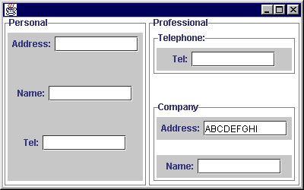
GUI For Customer Information Application
Adapted from Software Design: From Programming to Architecture by Eric J. Braude (Wiley 2003), with permission.

Slide 58
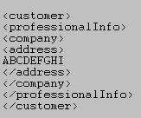
XML Output for Customer Information Application
Adapted from Software Design: From Programming to Architecture by Eric J. Braude (Wiley 2003), with permission.

Slide 59
Design Goal At Work: → Flexibility ←
Isolate the responsibilities of each part of the input form to generate its XML.
Adapted from Software Design: From Programming to Architecture by Eric J. Braude (Wiley 2003), with permission.

Slide 60
Class Model For User Information Collection
TextFieldListener
«client»
CustomerInfoElement
Each of these classes supports handleClick()
container
CustomerPersonal
CustomerAddress
Company
CustomerProfessional
CustomerName
CustomerInfo
CompanyName
CustomerInfoApp
«setup»
Adapted from Software Design: From Programming to Architecture by Eric J. Braude (Wiley 2003), with permission.

Slide 61
Object Model Fragment for Customer Information Example
container
: CompanyName
container
:Company
handleClick()
container
:CustomerProfessional
handleClick()
:CustomerInfo
handleClick()
Adapted from Software Design: From Programming to Architecture by Eric J. Braude (Wiley 2003), with permission.

Slide 62
Key Concept: → Chain of Responsibility Design Pattern ←
-- to distribute functional responsibility among a collection of objects.
Adapted from Software Design: From Programming to Architecture by Eric J. Braude (Wiley 2003), with permission.

Slide 63
Command Design Pattern
7 of 8

Slide 64
Command
Design Purpose
Increase flexibility in calling for a service e.g., allow undo-able operations
Design Pattern Summary
Capture operations as classes
Adapted from Software Design: From Programming to Architecture by Eric J. Braude (Wiley 2003), with permission.

Slide 65
The Command Design Pattern
Client
new approach
<<abstract>>
Command
execute()
old approach
Target1
action1()
Action1Command
execute()
Target2
action2()
Action2Command
execute()
Adapted from Software Design: From Programming to Architecture by Eric J. Braude (Wiley 2003), with permission.

Slide 66
Source Code Example
Command myCommand = Command.getCommand(. . .);
myCommand.execute();

Slide 67
The Command Design Pattern: Example
client
MenuItem
handleClick()
command
Command
execute()
command.execute()
document.cut()
CutCommand
execute()
document
Document
cut()
copy()
document.copy()
CopyCommand
execute()
document
Adapted from Software Design: From Programming to Architecture by Eric J. Braude (Wiley 2003), with permission.

Slide 68
Design Goal At Work: → Flexibility and Robustness ←
Isolate the responsibilities of the Word Processor commands, making them save-able and reversible.
Adapted from Software Design: From Programming to Architecture by Eric J. Braude (Wiley 2003), with permission.

Slide 69
Undo Example Class Model
Command
execute()
undo()
WordProcessor
commandHistory
0..n
document
Document
text: String
DocumentCommand
getInputFromUser()
document
UndoCommand
execute()
QuitCommand
execute()
CutCommand
textCut: String
offset: int
execute()
undo()
PasteCommand
offset: int
length: int
execute()
undo()
Adapted from Software Design: From Programming to Architecture by Eric J. Braude (Wiley 2003), with permission.

Slide 70
Key Concept: → Command Design Pattern ←
-- to avoid calling a method directly (e.g., so as to record or intercept it).
Adapted from Software Design: From Programming to Architecture by Eric J. Braude (Wiley 2003), with permission.

Slide 71
Template Design Pattern
8 of 8

Slide 72
Template
Design Purpose
Allow runtime variants on an algorithm
Design Pattern Summary
Express the basic algorithm in a base class, using method calls where variation is required
Adapted from Software Design: From Programming to Architecture by Eric J. Braude (Wiley 2003), with permission.

Slide 73
Example of Template Motivation
Required to solve equations of the form
ax² + bx + c = 0.
Must be able to handle all input possibilities for a, b, and c.
This is a tutorial application that must provide full explanations to users about the solutions for all values for a, b, and c.
Adapted from Software Design: From Programming to Architecture by Eric J. Braude (Wiley 2003), with permission.

Slide 74
A Basic Quadratic Algorithm
Report progress
Display number of solutions
Display first solution, if any
Display second solution, if any
Adapted from Software Design: From Programming to Architecture by Eric J. Braude (Wiley 2003), with permission.

Slide 75
Class Model for Template
Client
TemplateAlgorithm
handleRequest()
nonInheritedMethod()
calledMethod1()
calledMethod2()
….
Subject
doRequest()
algorithm
{ algorithm.handleRequest(); }
Algorithm1
calledMethod1()
calledMethod2()
….
Algorithm2
calledMethod1()
calledMethod2()
….
Algorithm3
calledMethod1()
calledMethod2()
….
Adapted from Software Design: From Programming to Architecture by Eric J. Braude (Wiley 2003), with permission.

Slide 76
Design Goal At Work: → Flexibility and Robustness ←
Isolate the main algorithm for quadratic solution display. Isolate the variants that depend on the coefficients.
Adapted from Software Design: From Programming to Architecture by Eric J. Braude (Wiley 2003), with permission.

Slide 77
Class Model for Quadratic Problem
Client
Setup
getABC()
<<abstract>>
QuadraticAlgorithm
displayWhatsHappening()
displaySolution()
inputMakesSense()
displayNumSolutions();
displayFirstSolution()
displaySecondSolution()
QuadraticEquation
float a, b, c
solveQuadratic()
myQuadraticAlgorithm
{ myQuadraticAlgorithm.displaySolution(); }
NoSolutions
displayNumSolutions()
displayFirstSolution()
displaySecondSolution()
OneSolution
displayNumSolutions()
displayFirstSolution()
displaySecondSolution()
TwoSolutions
displayNumSolutions()
displayFirstSolution()
displaySecondSolution()
InfinitelyManySolutions
displayNumSolutions()
displayFirstSolution()
displaySecondSolution()
Adapted from Software Design: From Programming to Architecture by Eric J. Braude (Wiley 2003), with permission.

Slide 78
Source Code Example
QuadraticEquation myQuadraticEquation;
myQuadraticEquation.solve();
abstract class QuadraticAlgorithm
{
}
class OneSolution extends QuadraticAlgorithm
{
}
class QuadraticEquation
{
QuadraticAlgorithm myQuadraticAlgorithm;
}

Slide 79
Key Concept: → Template Design Pattern ←
-- to capture a basic algorithm and its variants.
Adapted from Software Design: From Programming to Architecture by Eric J. Braude (Wiley 2003), with permission.

Slide 80
Summary of Behavioral Design Patterns
Behavioral Design Patterns capture behavior among objects
Interpreter handles expressions in grammars
Iterator visits members of a collection in a sequential fashion
Mediator captures behavior among peer objects without building a dependency between the objects
Observer updates objects affected by a single object
State allows method behavior to depend on current status
Chain of Responsibility allows a set of objects to provide functionality collectively
Command captures function flexibly (e.g. undo-able)
Template captures basic algorithms, allowing variability
Adapted from Software Design: From Programming to Architecture by Eric J. Braude (Wiley 2003), with permission.

